Slide 1
Configuring Browse Bibliographic Headings and Selection Display
Yoel Kortick
Senior Librarian

Slide 2

Agenda
Introduction
The configuration
Our sample records
Browse bibliographic headings before configuration change
Make a configuration change
Browse bibliographic headings after configuration change

Slide 3
Introduction
3

Slide 4
Introduction
It is possible to configure the display and sorting values for bibliographic headings as they appear in the “Browse Bibliographic Headings”
This helps librarians that are browsing through bibliographic headings to see the information they find relevant for their institution.

Slide 5
Introduction
For example, out-of-the-box, the heading type "Names", source code "Personal Name" is mapped to MARC21 field 100 $$a-d.
Now institutions can modify that mapping to other subfields as they find relevant, for example, field 100 $$a-d,q.

Slide 6
The configuration
6

Slide 7
The configuration
To support this functionality, a configuration table named “Bibliographic Headings Display Subfield Mapping” can be used to be added to the configuration of the bibliographic profiles.
This table shows the out-of-the-box values and the mapping that is currently implemented for the institution and enables the institution to define a new mapping of subfields.
For additional information see Configuring Browse Bibliographic Headings and Selection Display.

Slide 8
The configuration
Access the table “Bibliographic Headings Display Subfield Mapping” as follows:
Configuration > Resources > Cataloging > Metadata Configuration > Click relevant profile (for example “MARC21 Bibliographic)
Switch to ‘Other Settings’ tab > scroll down to ‘Configuration Tables’ section

Slide 9
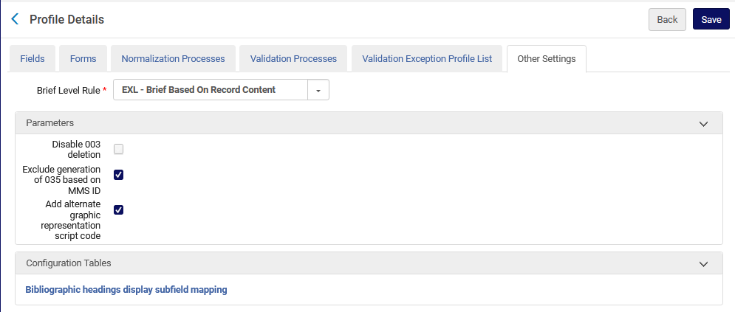
The configuration

Slide 10
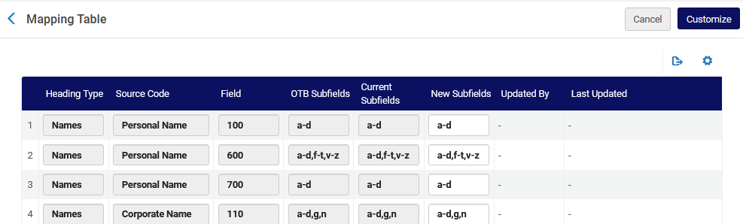
The configuration
Here is (part of) the table
Column to define new configuration
Current configuration
Default configuration

Slide 11
Our sample records
11

Slide 12
Our sample records
We have six sample records with a 100 field which has (among other subfields) a subfield q:
MMSID 100 field
99440387800121 $$a Fowler, T. M. $$q (Thaddeus Mortimer), $$d 1842-1922.
99440387700121 $$a Fowler, T. M. $$q (Thaddeus Mortimer), $$d 1842-1922.
99440387400121 $$a H. D. $$q (Hilda Doolittle), $$d 1886-1961, $$e author.
99440387300121 $$a H. D. $$q (Hilda Doolittle), $$d 1886-1961.
99440387200121 $$a Gresham, G. A. $$q (Geoffrey Austin)
99440387100121 $$a Gresham, G. A. $$q (Geoffrey Austin)

Slide 13
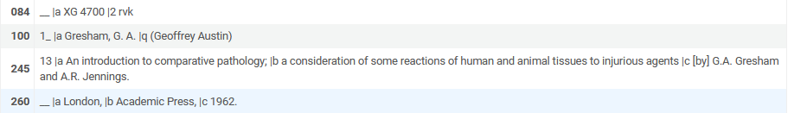
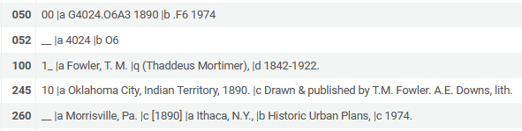
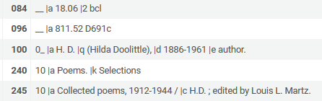
Our sample records
For example:

Slide 14
Browse bibliographic headings before configuration change
14

Slide 15
Browse bibliographic headings before configuration change
As we see in the first row of the table “Bibliographic Headings Display Subfield Mapping” :
Currently “names” is defined to show subfields a-d of the 100 field.
Subfield q is not defined to display

Slide 16
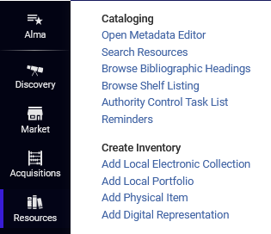
Browse bibliographic headings before configuration change
If we browse for bibliographic headings ‘Names” we do not see the subfield q from the 100 field from our sample records

Slide 17



Browse bibliographic headings before configuration change
Here we have subfields a and d
Here we have subfields a and d
Here we have subfield a

Slide 18
Make a configuration change
18

Slide 19
Make a configuration change
Instead of this where subfield q is not defined to display
We have defined the subfield q to display in addition to the a-d

Slide 20

Make a configuration change
Note: After changing the field “New Subfields” the “Current Subfields” will be aligned with the “New Subfields” after the indexing runs.
This is explained in Configuring Browse Bibliographic Headings and Selection Display:

Slide 21
Browse bibliographic headings after configuration change
21

Slide 22

Browse bibliographic headings after configuration change
Before
After
Now we also have subfield q

Slide 23

Browse bibliographic headings after configuration change
Before
After
Now we also have subfield q

Slide 24

Browse bibliographic headings after configuration change
Before
After
Now we also have subfield q

